Slide 1
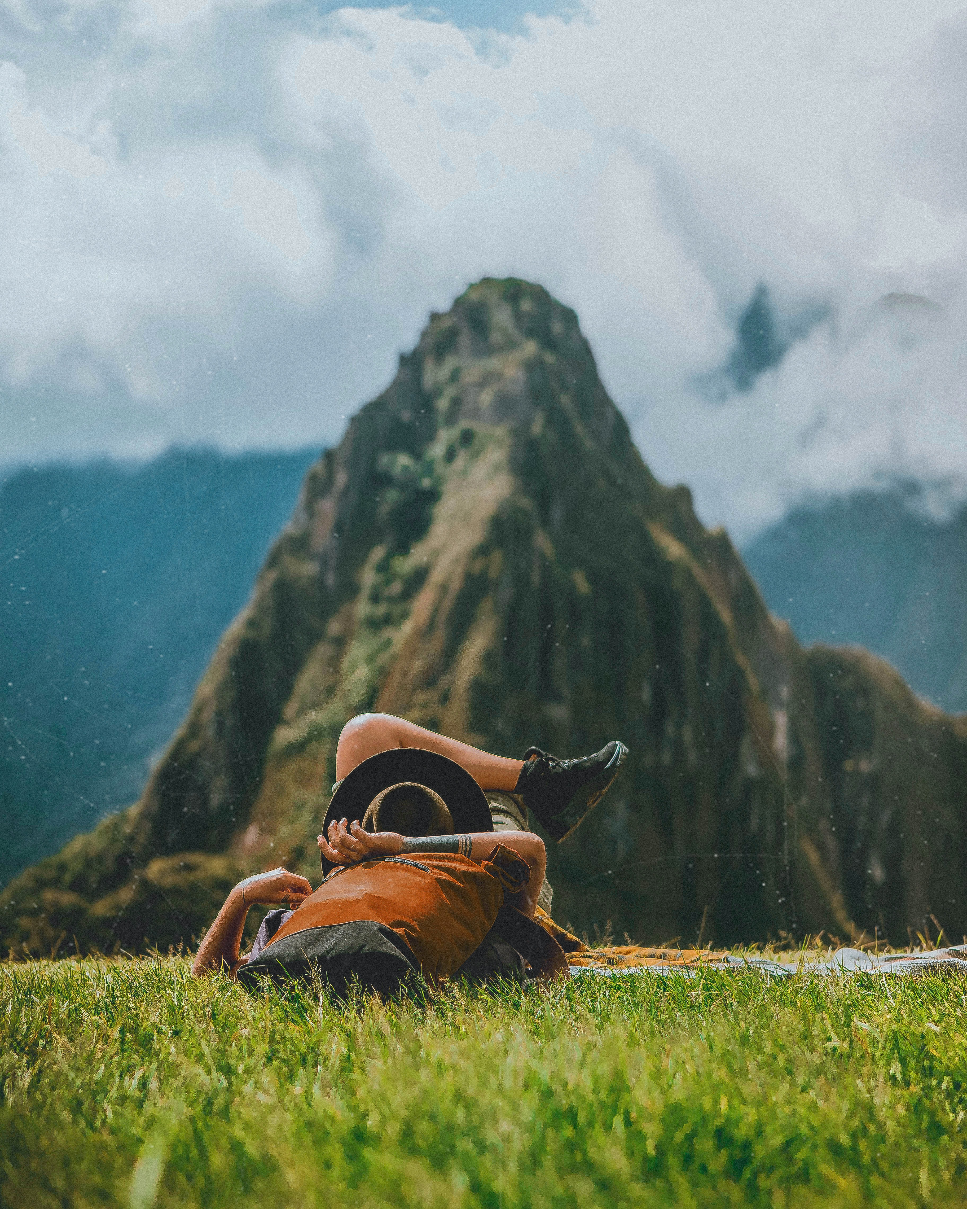
PR2761 Capstone Project II By: Marcus Pickett, Liam Dyer Computer Systems Engineering Tech Due: July 7, 2026
Duck Hunting/Identifying Guide iOS App

Slide 2
Project overview
Project Goal: The goal is develop an IOS app that helps duck hunters and bird watchers with identifying duck species in Newfoundland and Labrador, while also making navigation easier and improving outdoor safety.
Features:
Machine learning-based duck species identification.
GPS waypoint creation and navigation
Duck species database.
Habitat and behavioral information.
Live weather details using an API.
Benefits:
ML improves the species identification accuracy.
Provides info for ethical and legal hunting regulations.
GPS/Map reduces the risk of becoming lost.
Provides info specific to Newfoundland and Labrador duck species.

Slide 3
BACKGROUND
Newfoundland contains a vast number of wetlands, lakes, and forests that make navigation difficult and time consuming.
Current apps in the IOS store provide little support for Canadian duck species.
Accurate species identification is important for wildlife conservation and hunting regulations.
Machine learning has achieved approximately 96.8% accuracy in wildlife image classification (Tabak et al., 2020).

Slide 4
TECHONOLGOIES USED
Swift, a programming language created by apple for IOS devices.
XCode, the software used to write the swift code and display the software.
Core Location, Apple’s built in software for GPS and maps.
Weather API, service that allows weather data to be automatically retrieved .
Vision Machine Learning, an AI that analyzes and interacts with visual data.
Python script, to gather photos to create Vision ML
GitHub, a Website used to store all work and code to allow us partners to both have access at anytime.

Slide 5
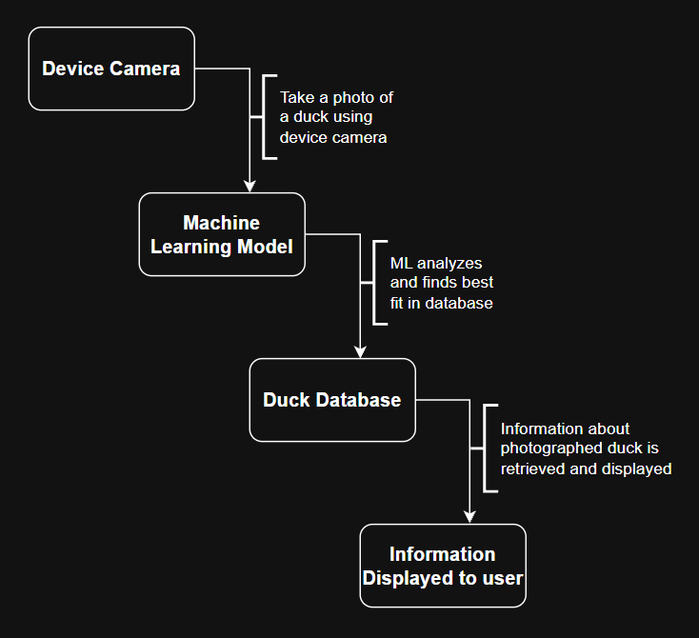
SYSTEM DESIGN
App Workflow Diagram
Additional Features:
Weather API integration.
GPS waypoint tracking.
Navigation assistance.
Offline species info.
Laws and Safety Guides

Slide 6
Current Work
Next Deliverable Goal: Complete the structure of the app, finish making Duck identifier ML, and complete most of the Report.
Ready to Start
The app structure is ready to be coded
The data collected and is ready to make the duck identifier ML
Report Structure is thought out and is ready to be completed
Finished
The data from Macaulay library has been collected
The Structure of the Duck Hunting app is planned out.
Sprint 1

Slide 7
REFERENCES
CodeWithChris. (2024, December 12). How to make an app in 8 days (2025 full tutorial) [Video]. YouTube. https://www.youtube.com/watch?v=uvLUJev1F20
Cornell University. (2026). Mallard - Anas platyrhynchos - media search - Macaulay Library and ebird. https://search.macaulaylibrary.org/catalog?taxonCode=mallar3
freeCodeCamp.org. (2019, December 16). APIs for beginners – How to use an API (Full course / tutorial) [Video]. YouTube. https://www.youtube.com/watch?v=WXsD0ZgxjRw
Statistics Canada. (2015, November). Forest land by province and territory (Table 3.7). https://www150.statcan.gc.ca/n1/pub/16-201-s/2011001/t015-eng.htm
Tabak, M. A., Norouzzadeh, M. S., Wolfson, D. W., Sweeney, S. J., VerCauteren, K. C., Snow, N. P., Halseth, J. M., Di Salvo, P. A., Lewis, J. S., White, M. D., Teton, B., Beasley, J. C., Schlichting, P. E., Boughton, R. K., Wight, B., Newkirk, E. S., Ivan, J. S., Odell, E. A., Brook, R. K., ... Miller, R. S. (2020). Improving the accessibility and transferability of machine learning algorithms for identification of animals in camera trap images: MLWIC2. https://onlinelibrary.wiley.com/doi/10.1002/ece3.6692
UlJah, W. (1992, January). Water Resources Atlas of Newfoundland. https://www.gov.nl.ca/ecc/files/waterres-cycle-hydrologic-water-resources-atlas-of-newfoundland-1992.pdf

